Slide 1

Research Report Update
Advisory Panel on the Question of Artificial Intelligence

Slide 2
Addressing the economic implications of weak Artificial Intelligence

Slide 3
Current Events Update
Deep Learning Finance Summit - a conference that talks about the use of AI in the financial sector by utilizing multiple algorithms that have different purposes
The AI Congress - a conference that will gather hundreds of leading enterprises, thought leaders and investors to talk about how applications of AI are benefitting real life companies
TechNova: AI in Financial Services 2018 - another conference that focuses on AI in the financial sector but talks about the potential of having AI in the sector

Slide 4
Positions of Key Players, Countries, and Organizations
Russia - it worked on utilizing machine learning and algorithms to project pro-Russia messaging into foreign media markets
United States - the world’s top investor in AI technology with the help of companies like Amazon, Google, Microsoft, Facebook, and IBM
China - it strives to implement AI in the form of automation in order to improve their efficiency on manufacturing
Japan - one of the historic leaders in robotics so it should be expected that Japan will continue to dedicate efforts into artificial intelligence
Canada - it has some of the world’s finest AI degree programs so it has a pool of people that will be more talented in the field of AI as time passes

Slide 5
Blocs that may emerge
There is no specific line between those for or against the usage of AI
Well-known technology and science leaders like Stephen Hawkings, Bill Gates, or Elon Musk have illustrated concerns about artificial intelligence
It doesn’t necessarily mean that they are completely against the use of AI
Most of them are optimistic about the vast amounts of benefits that AI may bring to humans but they caution researchers to focus on controlling AI so there will be more benefits than harm

Slide 6
Regulating autonomous weapons systems

Slide 7
Current Events Update
Munich Security Conference (15-18 February 2018) - is a conference joined by more than 600 politicians, business leaders, and officials to discuss Artificial Intelligence and modern conflict. At the conference, Germany made it clear that they have no interest in developing Autonomous Weapon Systems.
March 16th - Recently France had increased their investments in AI for future weapon systems to be developed. At the Man-Machine Teaming (MMT), Florence Parly made the announcement that they are increasing spendings and investments in such areas.

Slide 8
Positions of Key Players, Countries, and Organizations
United States - The US states that Autonomous Weapon Systems should be designed to allow human to exercise appropriate levels of human judgment over the use, however, the word “appropriate” can be interpreted very differently by different state actors or non state actors. The US maintains a weak stance on the issue, they set forth to say that it is too soon to be concerned about such issue.
Pakistan - Pakistan is the first and possibly devoted supporter of the call for the ban of autonomous weapon systems. They are concerned with the fact that these weapon systems are capable of changing the nature of war, due to the fact that these weapon systems would lower the threshold declare war and reduce the human cost of war; thus, undermining peace and security.

Slide 9
Positions of Key Players, Countries, and Organizations
International Committee of the Red Cross (ICRC) - The ICRC set forth to state that human control should be exerted over autonomous weapon systems, they call for a broad agreement in which human control must be retained.
Holy See - The Holy See suggests that prevention policies need to be implemented in the global community as autonomous weapon systems are constantly being developed. They further stated that it seems to be the best approach in solving such issue, saying that prevention methods is the only way to break race between technological progress of military means.

Slide 10
Blocs that may emerge
States that are unwilling to support strict regulations including:
United States
Russia
China
States that are willing to discuss such issue including:
Canada
France
Germany
States that supports a prohibition including:
Ecuador
Egypt
Cuba
Holy See
Pakistan
Uganda

Slide 11
Other Relevant Information
International Committee for Robots Arm Control(ICRAC) - defines lethal autonomous weapon systems (LAWS) as one that “can select targets and apply force without meaningful human control.”
A representative from the Human Rights Watch says at a UN meeting that the CCW is failing. As this is because all decisions have to be taken by consensus, however, there is no such consensus given that there is a lack of political will to discuss such issues.
A prohibition of LAWS would not inhibit the development of autonomous weapons but only forbid the selection and application of violent force against humans. Moreover, the ban on such weapon systems would not stifle technology.
Arms race is a potential threat that is beginning to emerge as LAWS is constantly being developed and implemented in war zones.
Civil Society, scientists, and technology companies are leading the development of preventive and prohibiting methods of banning autonomous weapons systems.

Slide 12
Methods to foster global cooperation on Artificial Intelligence research and development

Slide 13
Current Events Update
March 9 - the EU opens applications to join the High-Level Expert Group on AI
March 10 - China announces that it will soon publish detailed regulations on AI development to make breakthroughs in critical technologies
March 13 - US and Australia tech leaders enter an alliance to boost collaboration in health technologies, cybersecurity and AI
March 19 - G20 leaders discuss the implications of cryptocurrencies and the potential applications of its underlying technology at their annual summit

Slide 14
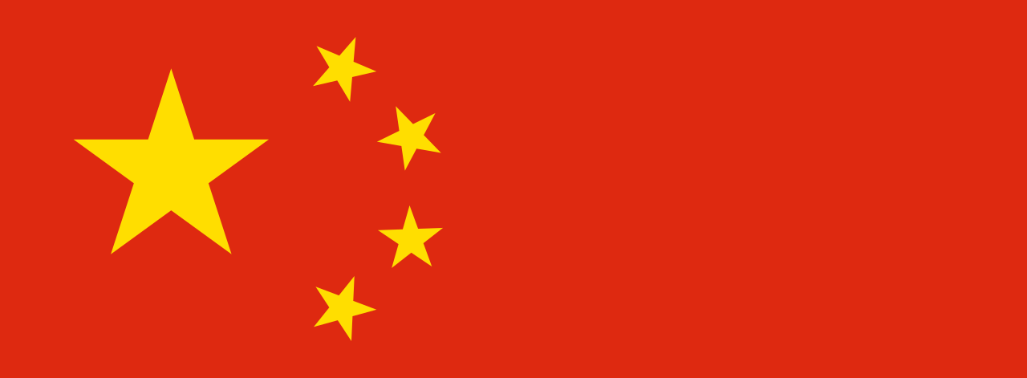
Positions of Key Players, Countries, and Organizations
China
Emerging global leader of AI development
Currently drawing up technical standards as an early attempt to control how AI evolves worldwide
All Chinese companies will have to adhere to these standards
Acts as a way to provide competitiveness for their companies, but also as a way to go from being a follower to setting the pace
Its booming AI industry and large government investments have raised concerns in the US
Has also demonstrated willingness for global cooperation
e.g. at Sino-French forum in early January, Chinese President Xi Jinping met with French President Macron to discuss the implications of AI and signed various agreements on cooperation in technology

Slide 15

Positions of Key Players, Countries, and Organizations
USA
Source of many new technological advancements
Silicon Valley - home to many start-up and global technology companies
NIPS conference in Long Beach - #1 place for presenting AI breakthroughs
Lacks a clear plan to keep pace with foreign rivals
generally relying on commercial research and development
collecting data and applying it to two primary areas (virtual reality and computer vision), but should focus on broader applications of AI
U.S. Congress tax plan threatens to raise costs for graduate students, reducing funding for fields including AI and tightening of rules on immigration for international researchers
President Donald Trump’s “America first” mindset may hinder global cooperation

Slide 16

Positions of Key Players, Countries, and Organizations
Tech Companies
Over the last five years - 90% of Silicon Valley’s AI startups acquired by leading tech companies
A strategy aimed first at getting the talent in-house and depriving competitors of AI talent
Strategy doesn’t just depriving their competition of talent, but also the rest of the economy
Undercutting 95% of the impact AI could have on the global economy and society at large
Tech giants buy up companies and direct their to focus on R&D, rather than building AI applications for specific, non-tech industry problems
Public-private partnerships are crucial in fostering global cooperation seeing as these tech companies are major stakeholders
Main challenge is that these companies prioritize their own financial interests, which is driven by the competitive nature of business.

Slide 17


Blocs that may emerge
Developed Nations v. Developing Nations
Leaders of AI: Russia, China, US, Japan, Israel, Estonia, Canada
Increasing focus and investment towards AI in an attempt to dominate the sector
Funding for global AI startups has grown at a 60% compound annual growth rate since 2010
Generally do not have the financial capacity or infrastructure for AI
Would gain the most from AI in farming, healthcare and resource provision
Increased use of robots in developed countries risks eroding the traditional labor-cost advantage of developing countries
widens gap between elites’ productive capacity and that of everyone else

